Slide 1

Carma

Slide 2





Number of vehicles across India
2013
2014
2015

Slide 3




















YASH
GUPTA
living in Bengaluru, India
40
Married
years
Yash is working 8 months a year in Bengaluru and 4 months a year in Frankfurt.
IT Consultant
160k ₹ per month
PhD
Technology Score
Interests
Social
Media
Friends
holidays
movies
relaxing
230
iPhone 8
Most-Used Apps
98%
Bitcoin,
Ether

Slide 4




NISHI
JAIN
living in Delhi, India
22
Single
years
Nishi is an exchange student from Delhi and studies at the CU in Bengaluru.
Student at Christ University
30k ₹ per month
Bachelor Degree
Technology Score
Interests
Social
Media
Friends
199
Samsung
Galaxy
dogs
relaxing
yoga
Most-Used Apps
84%
-

Slide 5



Carma
Car Rental Management Architecture

Slide 6


Slide 7
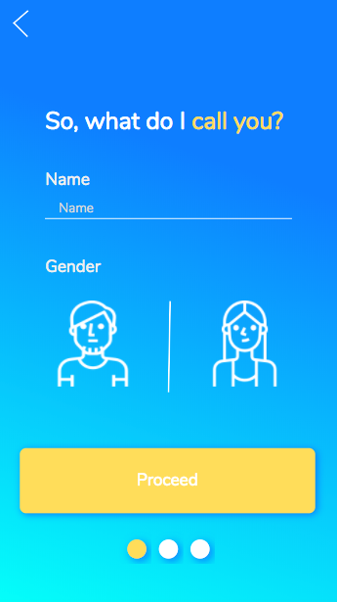

Slide 8
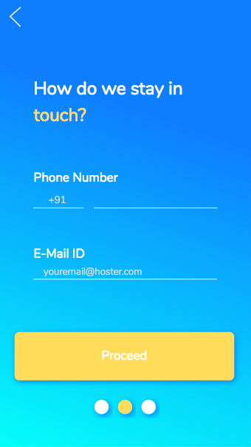

Slide 9
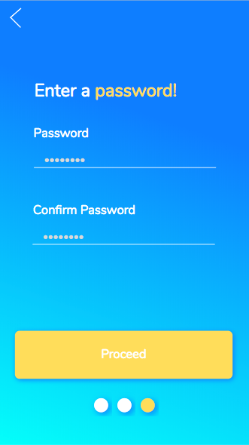

Slide 10
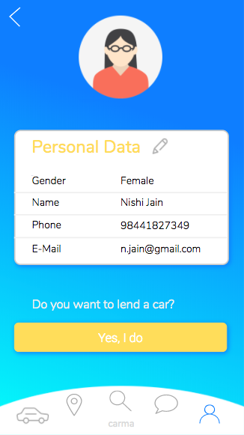

Slide 11
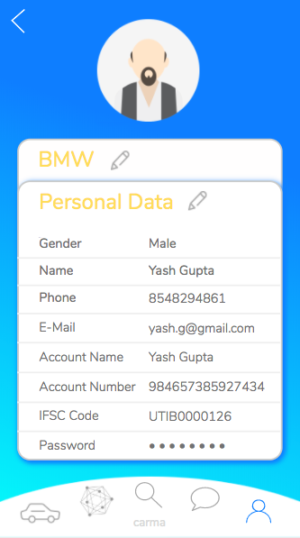
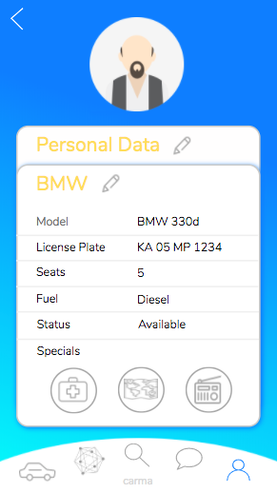

Slide 12
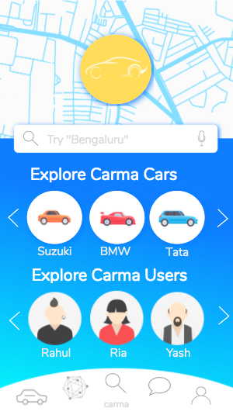

Slide 13
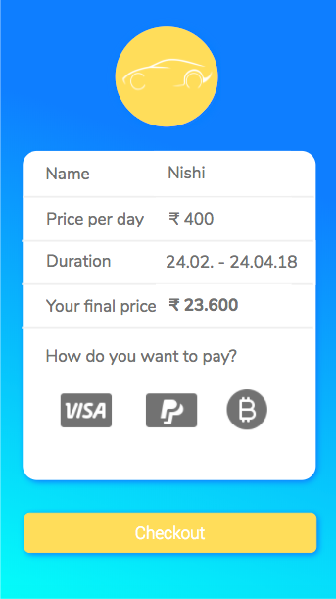

Slide 14
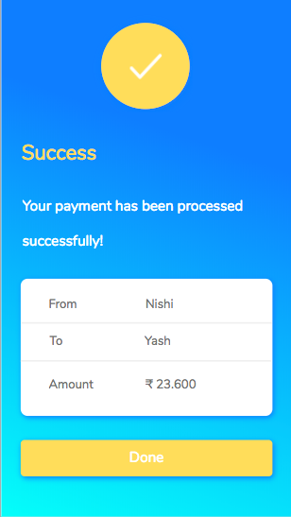

Slide 15
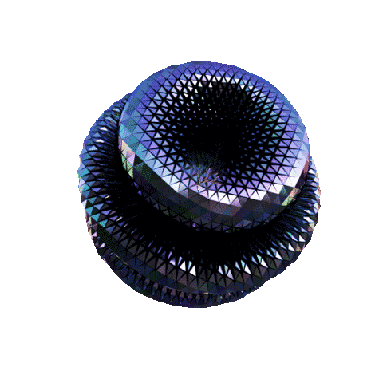
How does Carma work?

Slide 16


Participants

Slide 17
Owner
Wants to give his car for rent.

Slide 18
Customer
Wants to rent a car.

Slide 19
Assets

Slide 20

CARS
0 AVAILABLE
1 BOOKED

Slide 21

Transactions

Slide 22

Renting
From-to-Date

Slide 23

THE PROCESS

Slide 24
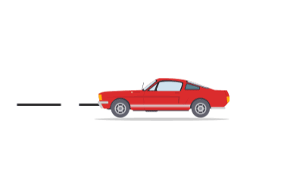
OWNER ADDS A CAR AVAILABLE TO BE RENTED

Slide 25

Customer finds a suitable car and requests the car.

Slide 26


Then the booking gets confirmed!
If the dates are in range,

Slide 27


Participant resources are changed
Owner
Customer

Slide 28

Customer becomes asset’s temporary owner.

Slide 29

And a new block is added to the chain.

Slide 30




DATA
Hash
Hash Of Previous Block

Slide 31

Hash
796E9ED479F15D064581DFA30575EF0910CB9706

Slide 32


DATA
YASH
GUPTA
AGE
40 years
Car Details
Transaction details
Gender
MALE
Model
BMW 330d
Yash is working 8 months a year in Bengaluru and 4 months a year in Frankfurt.
Nishi
TO:
KA 05 MP 1234
Licence No.
Bank Details
Seats
5
From:
Yash
Fuel
Diesel
9542336554233-6542
Amount:
Rs. 23,600
Status
Available
ICICI BANK

Slide 33
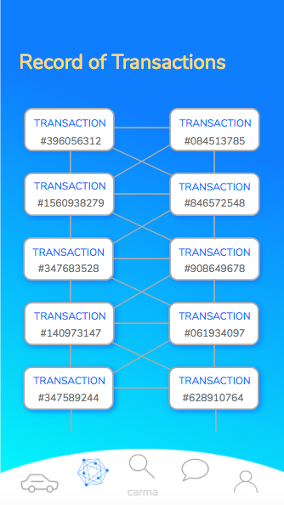
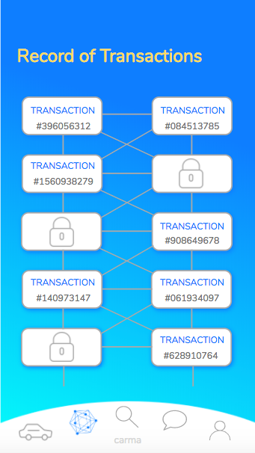
OWNER
CUSTOMER

Slide 34
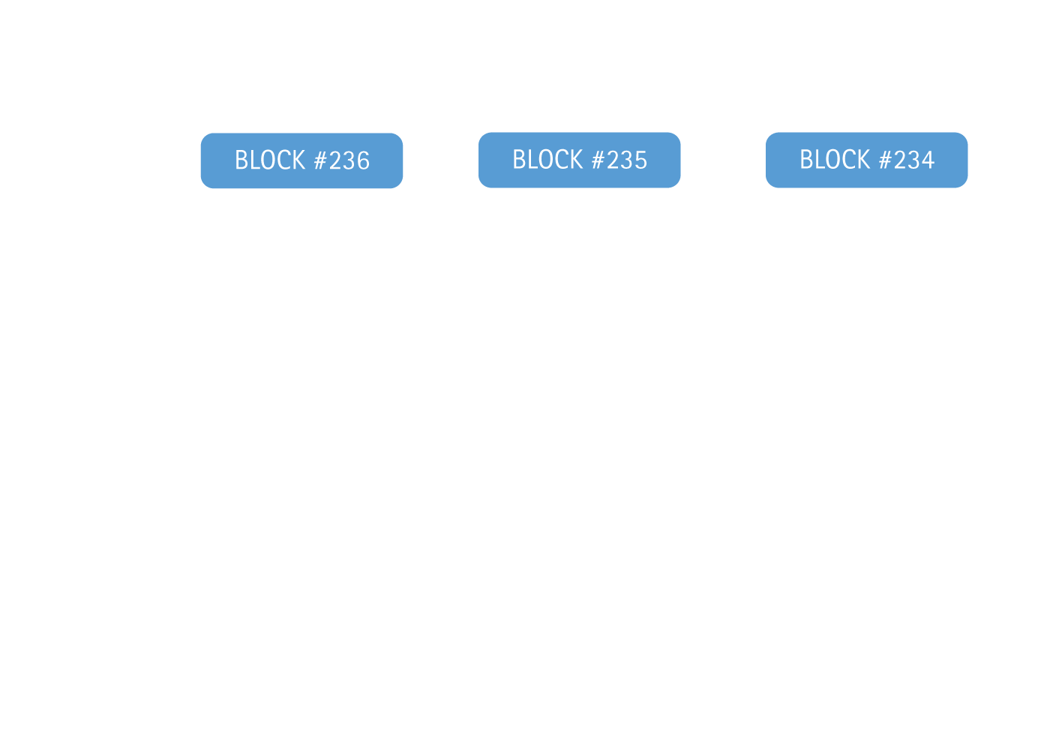
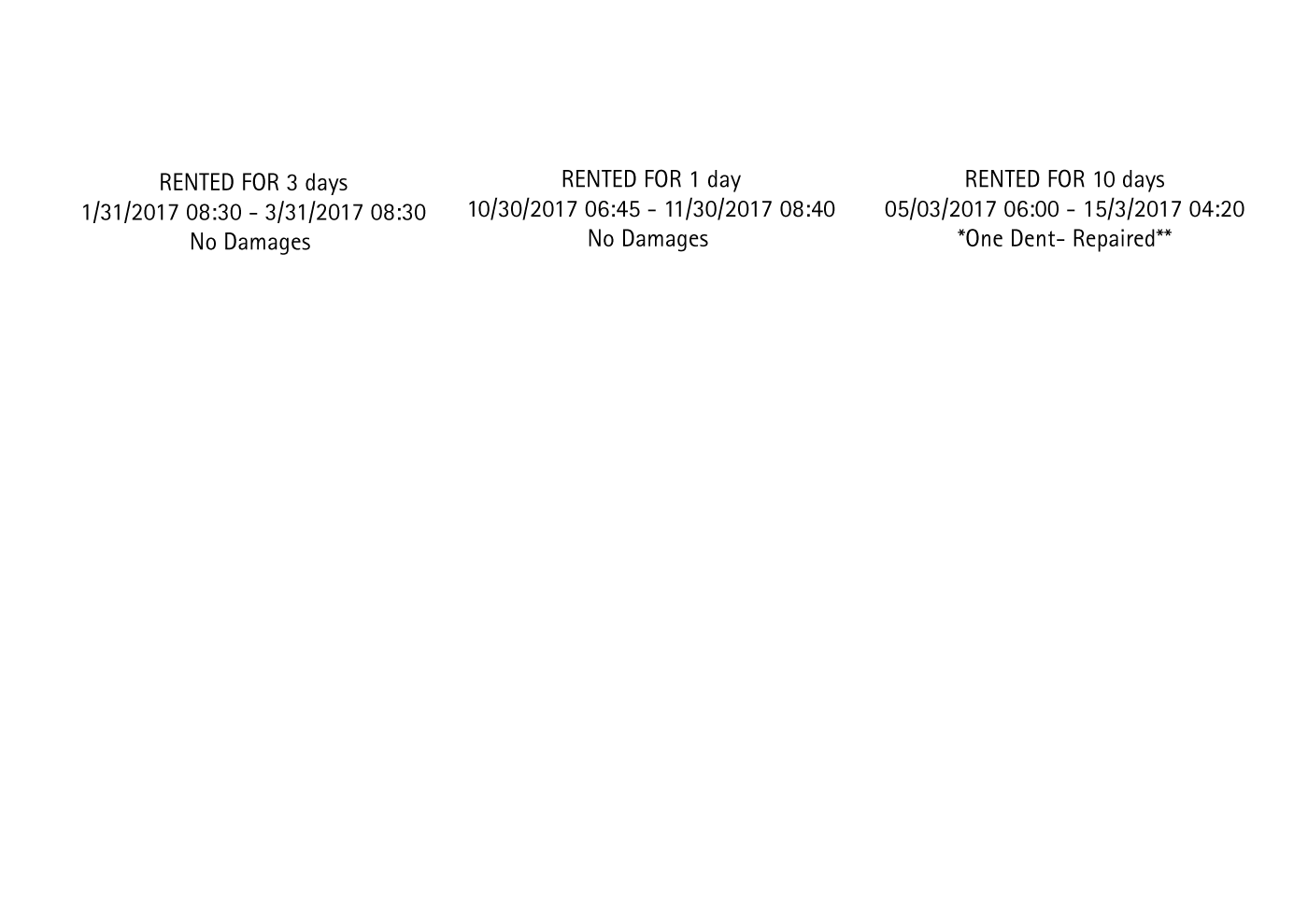
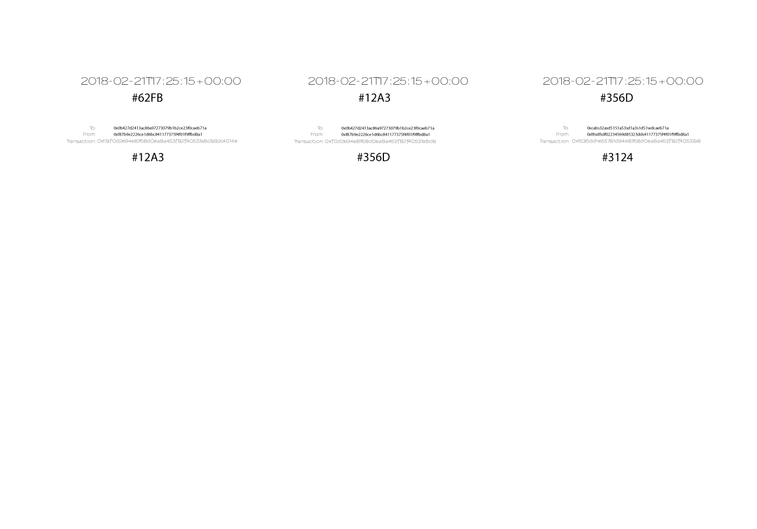




Fully Transparent Network

Slide 35

YOU JUST GOT SERVED

